Slide 1
Team GSSK
Gansaikhan Shur, Sachin Karki, Shristi Chapagain, Kinsey Younggren

Slide 2
Introduction

Slide 3
Cobber Chat
Simple chat app
Building a web application
Has Low traffic usage
Uses a database to store informations
One to One chat application (No Group Chat)

Slide 4
2. Work Performed so far

Slide 5
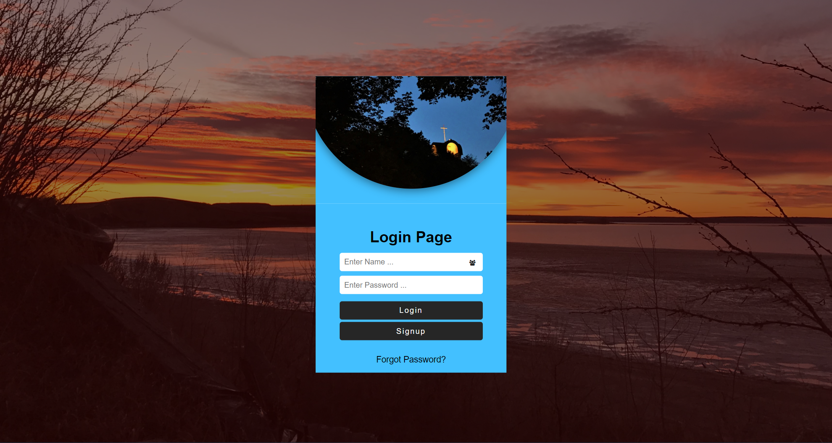
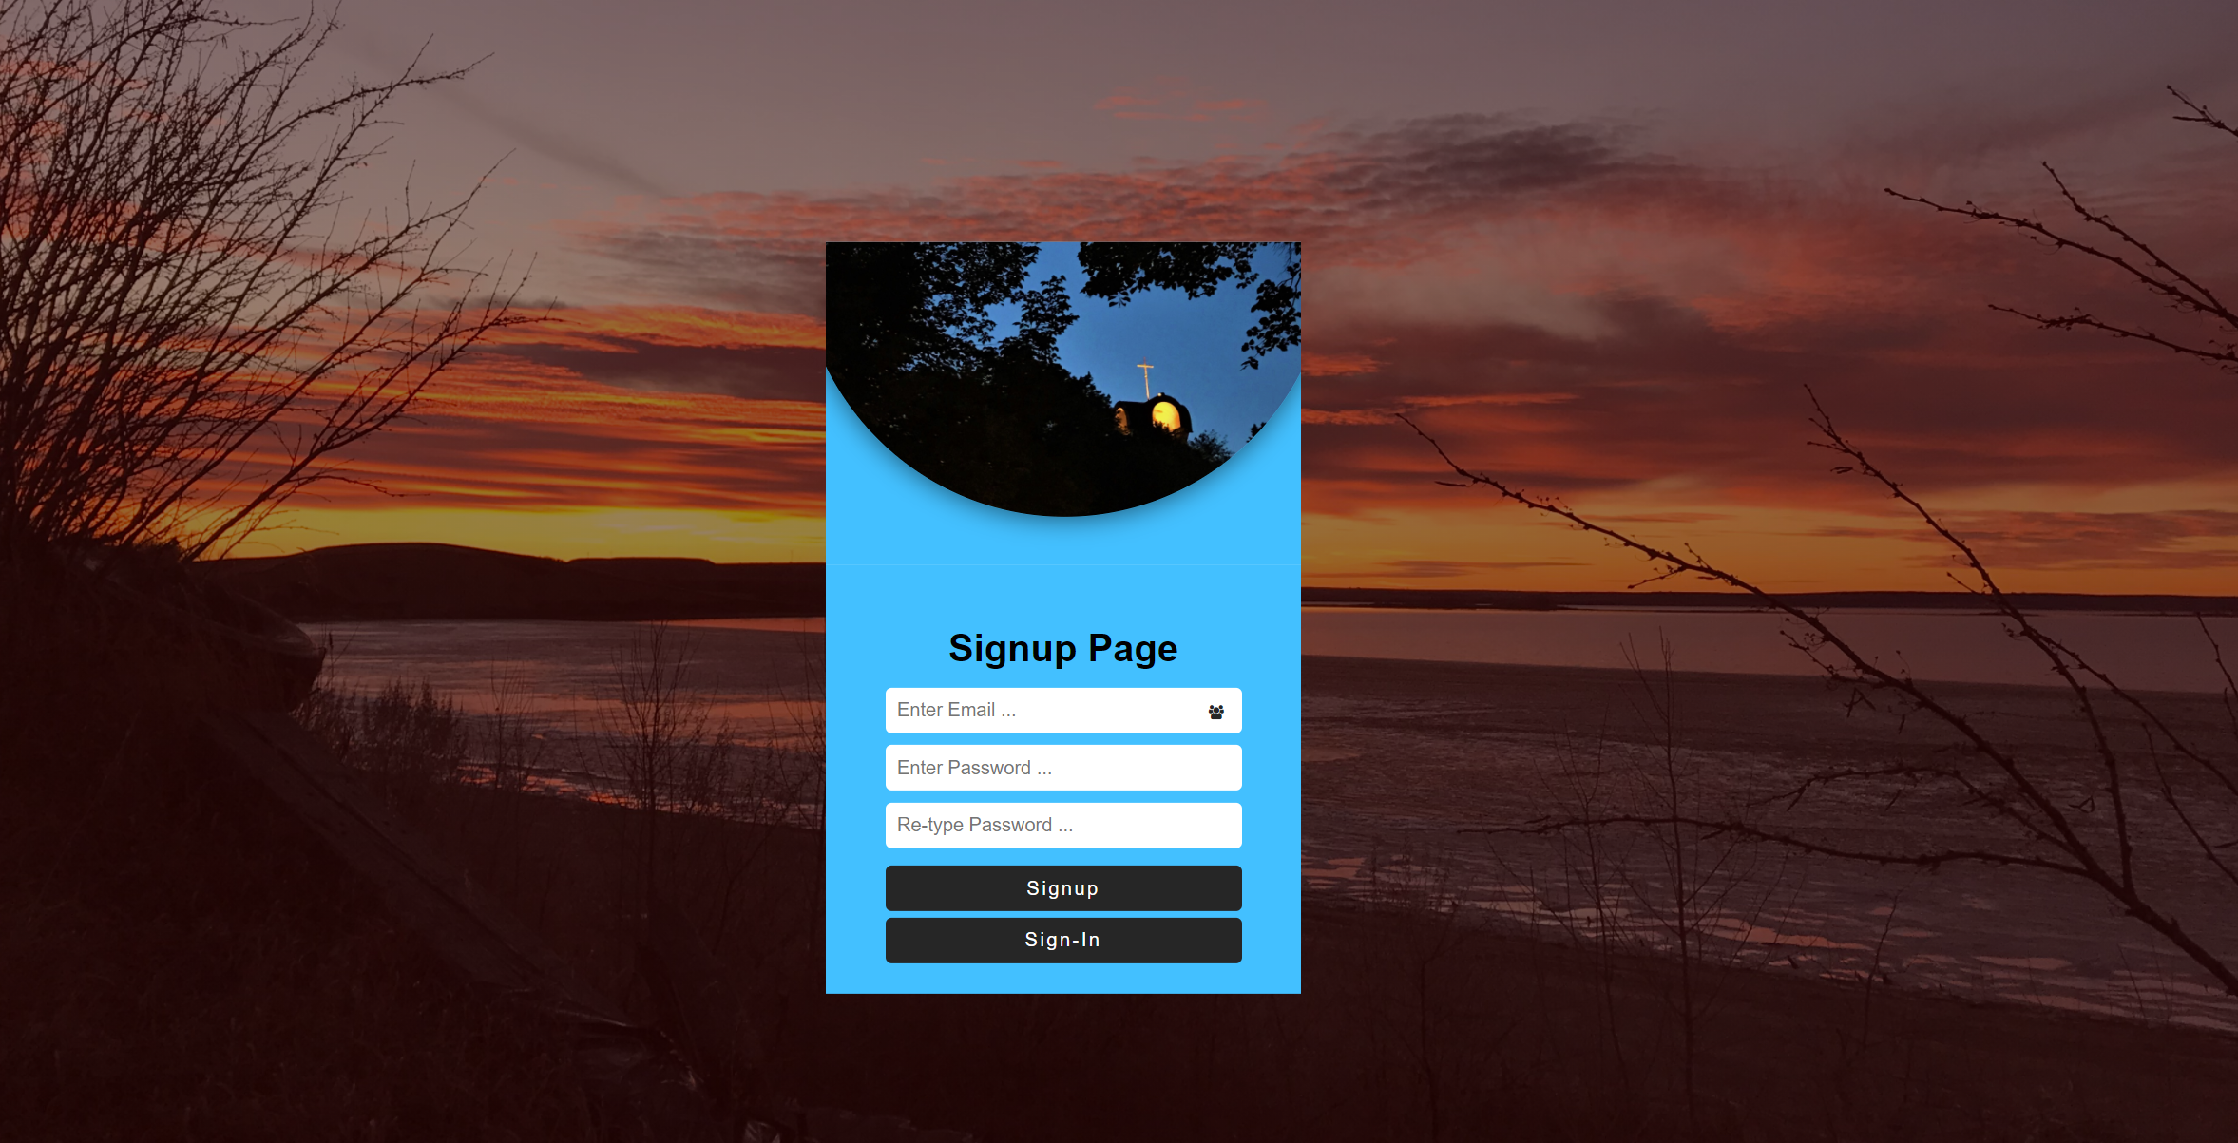
Login/Signup Page:
Designed using HTML and CSS.
Lets user login, sign up or recover forgotten password

Slide 6
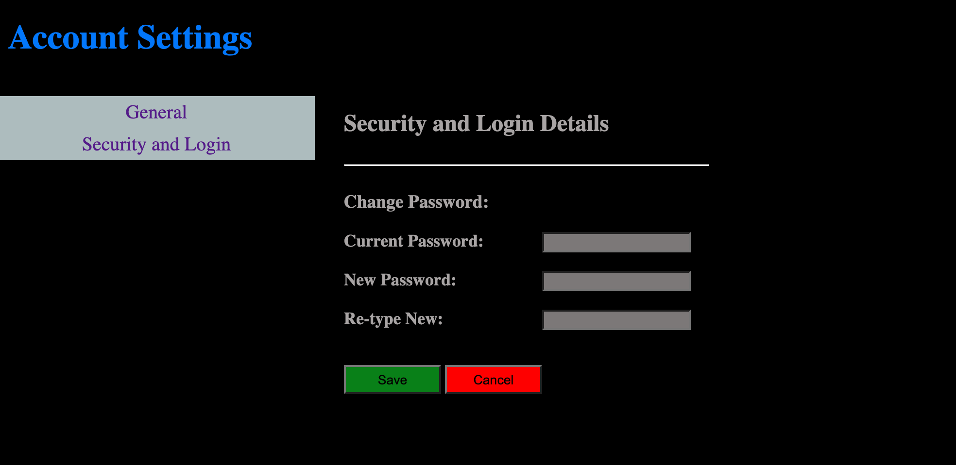
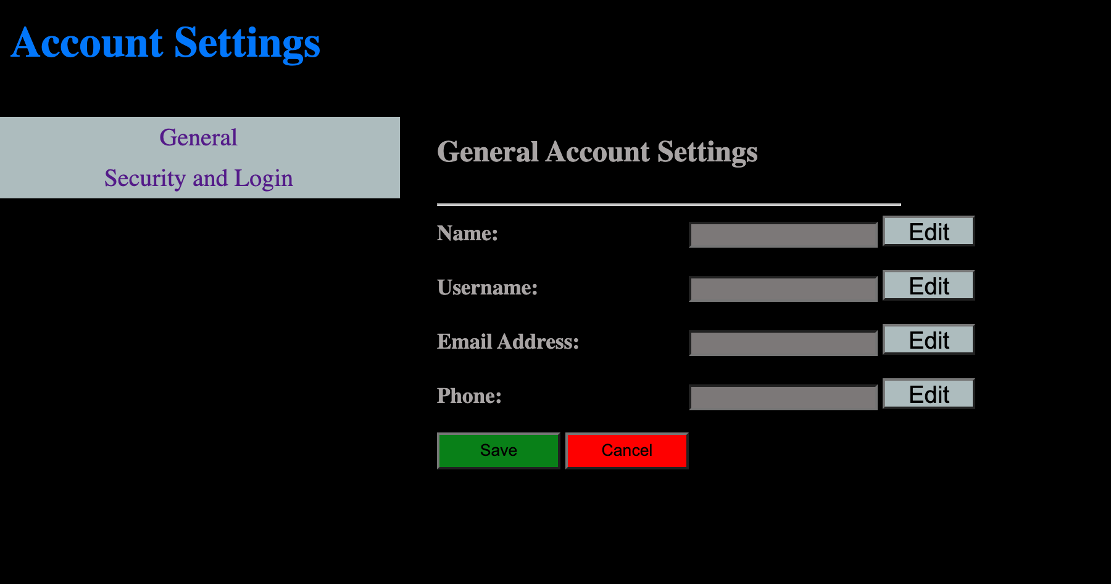
Settings Page:
Designed using HTML and CSS.
Data stored in database (for now)
Working on accessing the database

Slide 7
3. What has gone well?

Slide 8
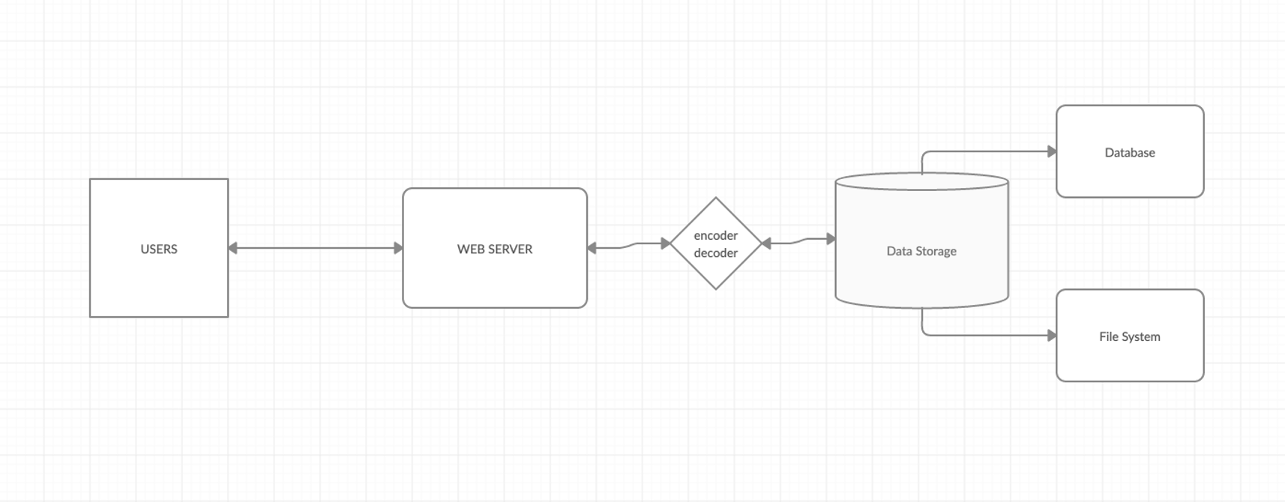

Slide 9
Project Planning
Team work
Consistent meetings
Individual effort
Healthy communication
Experimenting with different tools

Slide 10
4. Challenges

Slide 11
Limited time
No physical meetings
Lack of in-depth knowledge
Some members are new to this environment
Time management between other projects

Slide 12
5. Plan for remaining work

Slide 13
Finish up remaining pages (HTML/CSS)
Link pages together
Implement database
Work on the networking side
Create a networking map
Implement the network
Finish up core application using C#

Slide 14
6. Conclusion!

Slide 15
Need more effort
Stay up to date with milestone
Follow rubrics
Communicate more
Take help online or from members
Enjoy as we go on!
Don’t Die!

Slide 16
Thanks!
Any questions?

